Slide 1
Error Handling
Module 9

Slide 2
Module Objectives
Describe what errors and exceptions are
Handle errors and exceptions when they occur
Define and use your own custom exceptions

Slide 3
Lesson 9.1: Errors and Exceptions in Python
Exceptions: Errors that occur when program is running.
Syntax errors: Errors that occur before program execution happens.

Slide 4
Lesson 9.1.1: How to Raise Exceptions (1 of 2)
Use raise keyword.
May want to raise exception when something occurs that you want to inform users of.
For example, incorrect input.
Snippet 9.1 shows function that raises error.

Slide 5
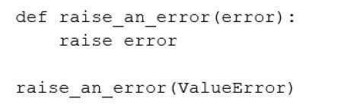
Lesson 9.1.1: How to Raise Exceptions (2 of 2)
Snippet 9.1

Slide 6
Lesson 9.2: Built-In Exceptions
Python ships with built-in exceptions.
Divided into:
Base error classes.
Concrete error classes.

Slide 7
Lesson 9.2.1: SyntaxError
Very common.
Occurs when Python interpreter unable to parse line of code.

Slide 8
Lesson 9.2.2: ImportError
Occurs when import cannot be resolved.
Example: Importing a non-existent module raises ModuleNotFoundError which is subclass of ImportError

Slide 9
Lesson 9.2.3: KeyError
Occurs when trying to access dictionary key that isn’t found.
Simple way to mitigate is to use get method.
Returns None or custom value if key doesn’t exist.

Slide 10
Lesson 9.2.4: TypeError (1 of 2)
Occurs when attempting to do operation on value or object of wrong type.
Snippet 9.19 shows example of adding string to int
Also occurs when passing wrong arguments.

Slide 11
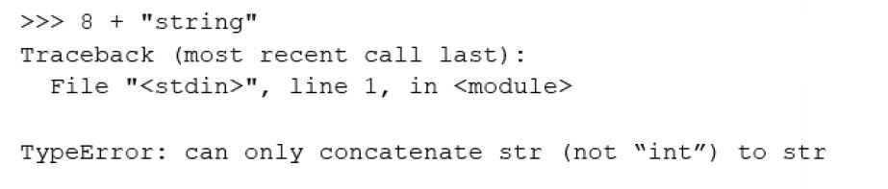
Lesson 9.2.4: TypeError (2 of 2)
Snippet 9.19

Slide 12
Lesson 9.2.5: AttributeError
Raised when assigning or referencing an attribute fails.
For example, will occur when attempting push method on list object
list object doesn’t have push attribute.

Slide 13
Lesson 9.2.6: IndexError
Occurs when trying to access index that doesn’t exist.
For example, in a list

Slide 14
Lesson 9.2.7: NameError
Occurs when specified name cannot be found locally or globally.
Usually happens when name or variable is not defined.

Slide 15
Lesson 9.2.8: FileNotFoundError
Raised when file you are attempting to read or write is not found.

Slide 16
Lesson 9.3: Handling Errors and Exceptions
Practice defensive programming to mitigate errors.
Will improve software and source code in terms of:
General quality
Source code (more comprehensible)
Software (behave more predictably)

Slide 17
Lesson 9.3.1: Implementing the try…except Block (1 of 2)
Simplest way to handle errors.
If code in try block throws error specified in except block, code in except block executes.
Can handle multiple exceptions, including generic exception.
See Snippet 9.36 for example.

Slide 18
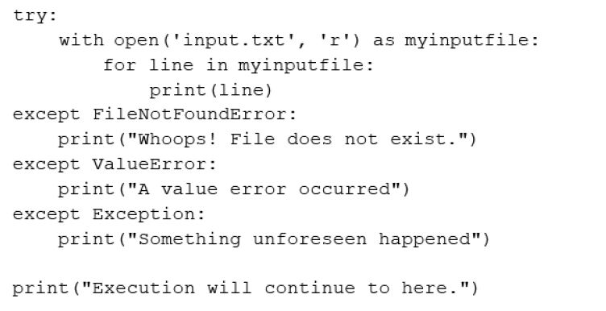
Lesson 9.3.1: Implementing the try…except Block (2 of 2)
Snippet 9.36

Slide 19
Lesson 9.3.2: Implementing the try…except…else Block (1 of 2)
Modification of try…except block.
Code in else block is always executed if no error occurs.
See Snippet 9.43 for example of use.

Slide 20
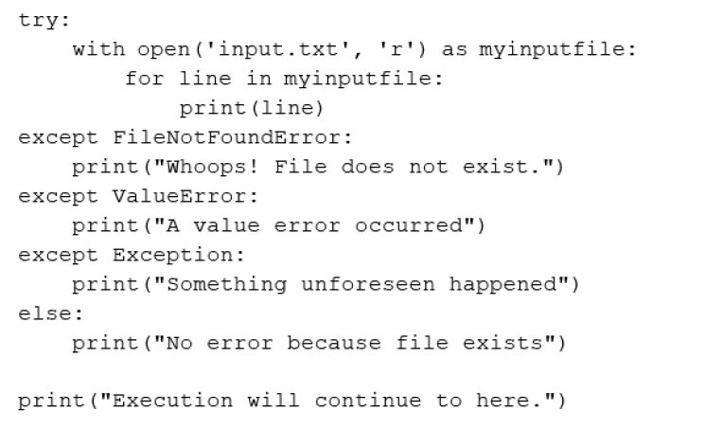
Lesson 9.3.2: Implementing the try…except…else Block (2 of 2)
Snippet 9.43

Slide 21
Lesson 9.3.3: Implementing the finally Keyword
finally keyword defines code block that must execute before try…except block exits, irrespective of whether any exception occurred.
Usually the last block in the try…except block.
Useful in cases where clean-up logic needs to execute.
For example, releasing system resources.

Slide 22
Lesson 9.4: Custom Exceptions
Python allows you to add custom errors by extending base Exception class.

Slide 23
Lesson 9.4.1: Implementing Your Own Exception Class (1 of 2)
Exception names should end with Error.
Should contain few attributes that will help user get more information about what error occurred.
Snippet 9.54 shows example of how to create error.

Slide 24
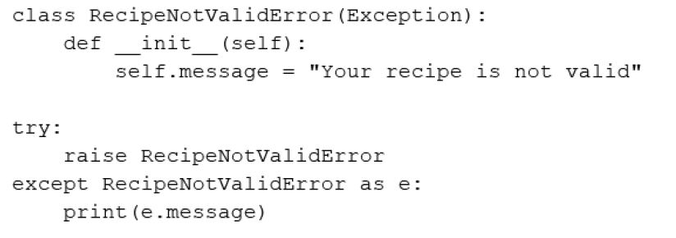
Lesson 9.4.1: Implementing Your Own Exception Class (2 of 2)
Snippet 9.54

Slide 25
Summary
In this module:
We talked about errors and exceptions, what they are, and how to avoid them.
We looked at a few built-in errors and the scenarios that would cause them to be raised.
We then moved on to handling them by using try…except and finally blocks.
We also covered how to implement our own custom exceptions by using the Exception base class.

